Slide 1

STAT-632 Project
Submitted by: Abhishek Sendil Kumar(hh6249)
Jessica Grover(lx3005)
Submitted to: Prof. Joshua Kerr

Slide 2
Introduction
While we are presenting the Titanic dataset, we have developed a model that predicts the Survival rate of passengers who were on-board on Titanic.
The titanic dataset contains many variables such as the Name, Age,Sex,the category class, the ticket fare,ticket number and the cabin that they were travelling in.
In our model we decided to predict the survival rate by selecting Age,Sex,class that they were travelling as our predictor variables and “survived” as our response variable.

Slide 3
Challenges
Most datasets had variables that were descriptive and qualitative in nature.
They did not have variables that were quantitative and having discrete values which was something we were looking for.
Another challenge that we faced was that we weren't able to get a data set that had less missing values.
When we were surfing Kaggle we came across the Titanic Dataset which we were able to relate to and it was meeting our requirements so we went ahead with that as the titanic data set had categorical values which we were looking for.
We went with bar plots as opposed to box plots because the titanic data-set had categorical values.

Slide 4
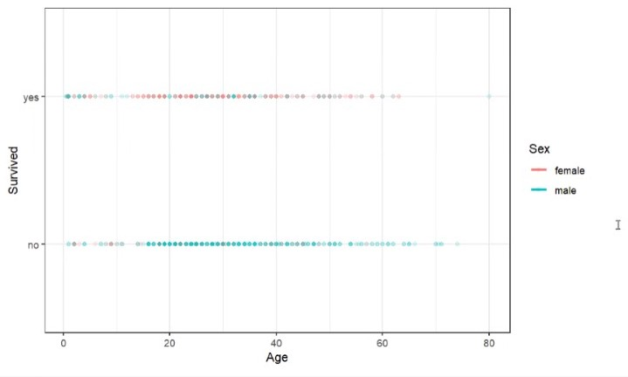
Selection mechanism
We selected our 3 predictors Age,Sex,Pclass from the data set and when we plotted a scatterplot we saw that are values were between 0 and 1 (Probabilistic)
We were getting an intuition that developing a multiple logistic regression model would be ideal for predicting the survival rate of the passengers and which is what we went by.
Notes:
This graph appears to be a sigmoid function and therefore we are goig ahead with multiple reg. No ppoints in middle..

Slide 5
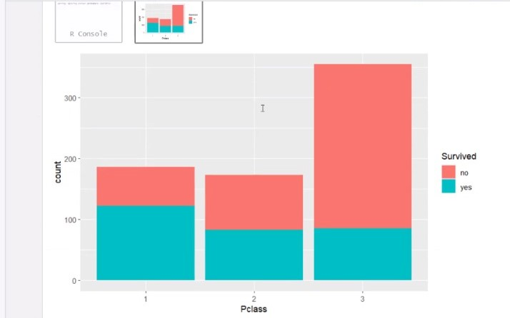
Representation
A bar plot is used to display the relationship between numerical and categorical values.
As you look at the bar plots you will notice how the trend varies for male and female vs survived or not.

Slide 6
Effectiveness of the model
We have used Cross Validation to see how efficient our model is.
Here we split our data set into 70:30 ratio where we use 70% of our model towards training and 30 % towards testing .
We could see that when we printed a regression summary on the testing model our variables were significant in nature and that they were independent from one and another.

Slide 7
Performance of the model
For inspecting the classification model performance, we have used confusion matrix.
A confusion matrix is a simple table displaying the number of true positives/negatives and false positive/negatives, or in other words how often the algorithm correctly or incorrectly predicted the outcome.
We have used confusion matrix to compute various classification metrics (accuracy, sensitivity, and specificity) on the test set.

Slide 8
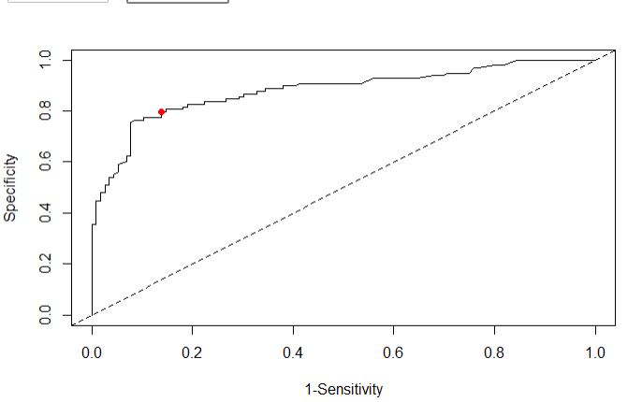
Graphical representation
To evaluate how the model is accurate in predicting, we have used ROC curve. ROC (Receiver Operating Characteristics) curve is a plot of sensitivity versus 1-specificity for a variety of probability thresholds between 0 and 1. Here we can see that our ROC curve is between 90%.

Slide 9
AUC
Another popular classification metric is the area under the ROC curve (AUC).
The closer the AUC is to 1 the better the model performs at classification. While a model that performs no better than random guessing would have an AUC close to 0.5.
The AUC that we got was approximately 88% which means that our test model performs better but not the best as it isn't closer to 1.

Slide 10
Conclusion
While we look at our scatter plot we notice that we have a lot of females who survived compared to males.
This is exactly what the titanic movie depicts that most women and children were prioritized compared to men and that’s how the survival rate worked too.
In our roc curve we got a value between .90 and 1 which does qualify as a good fit for the model.
Our AUC was 88% which also implies that our model is good fit.
We used the Testing model and printed out the regression summary and found out that the predictors we had chosen were statistically significant.
Notes:
Let me show u the graph…

Slide 11

THANK YOU!!
Any questions ?
(Hopefully not)

